Slide 1
Access Specifiers
All members of a class can be accessed:
Within the class - No restriction.
From outside the class - ?

Slide 2
Access Specifiers
- Defines the access control
Public
Private
Protected
Access specifiers define how a member's variables and member's functions of a class can be accessed from outside the class.
Notes:
These access specifiers are used to set boundaries for availability of members of class be it data members or member functions
Access specifiers in the program, are followed by a colon. You can use either one, two or all 3 specifiers in the same class to set different boundaries for different class members. They change the boundary for all the declarations that follow them.

Slide 3
Access Specifiers
Private
Access Denied - Outsiders
Notes:
Private:
The class members declared as private can be accessed only by the functions inside the class. They are not allowed to be accessed directly by any object or function outside the class. Only the member functions or the friend functions are allowed to access the private data members of a class.The class members declared as private can be accessed only by the functions inside the class. They are not allowed to be accessed directly by any object or function outside the class. Only the member functions or the friend functions are allowed to access the private data members of a class.

Slide 4
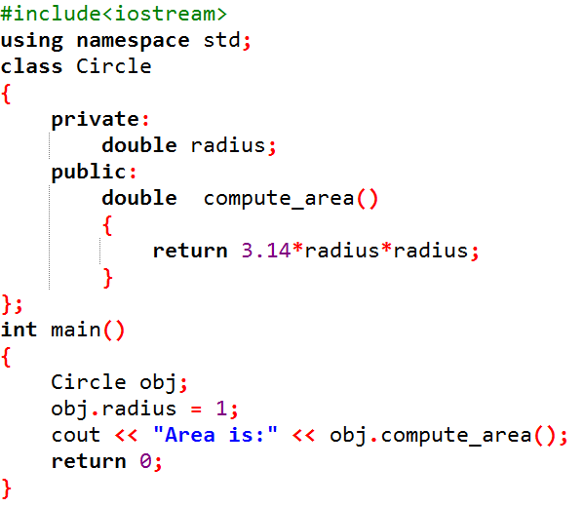
Output:
Error
"double radius declared private here"

Slide 5
Access Specifiers
Private
Any object or function outside the class cannot access the private members.
Access Denied - Outsiders

Slide 6
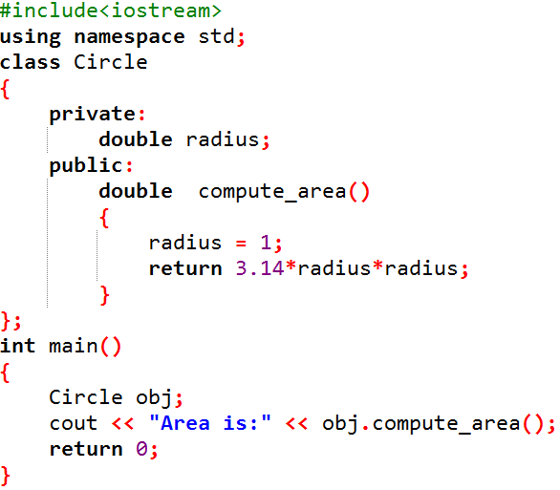
Output:
Area is: 3.14

Slide 7
Access Specifiers
Private
Any object or function outside the class cannot access the private members.
Can be accessed only by the functions inside the class and friend functions.
Access Denied - Outsiders

Slide 8
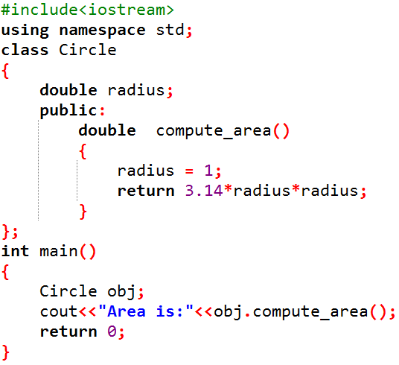
Output:
Area is: 3.14

Slide 9
Access Specifiers
Private
Any object or function outside the class cannot access the private members.
Can be accessed only by the functions inside the class and friend functions.
By default all the members of a class would be private.
Access Denied - Outsiders

Slide 10
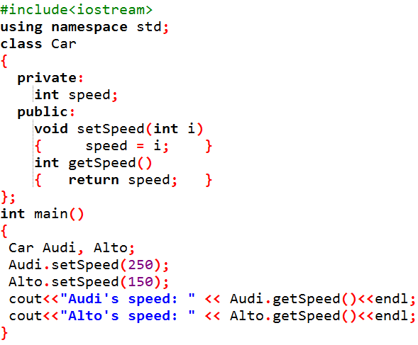
Accessing Private Data Members:
Need to create functions to get and set the value of a private data member.
Can be accessed only by the functions inside the class and friend functions.
Notes:
Accessing Private Data Members
To access, use and initialize the private data member you need to create getter and setter functions, to get and set the value of the data member.
The setter function will set the value passed as argument to the private data member, and the getter function will return the value of the private data member to be used. Both getter and setter function must be defined public.

Slide 11
Access Specifiers
Proctected
A protected member variable or function is very similar to a private member
But they can be accessed by any subclass (derived class) of that class.
Notes:
Protected:
Protected access modifier is similar to that of private access modifiers, the difference is that the class member declared as Protected are inaccessible outside the class but they can be accessed by any subclass(derived class) of that class.

Slide 12
Access Specifiers
Public
Notes:
Public:
All the class members declared under public will be available to everyone. The data members and member functions declared public can be accessed by other classes too. The public members of a class can be accessed from anywhere in the program using the direct member access operator (.) with the object of that class.

Slide 13
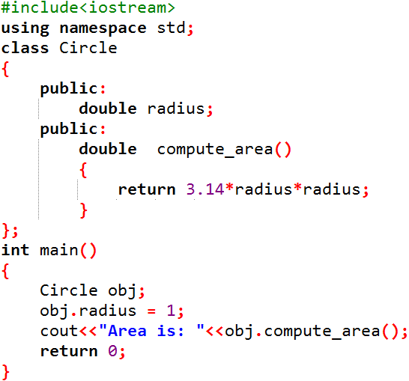
Output:
Area is: 3.14

Slide 14
Access Specifiers
All the class members declared under public will be available to everyone.
Public members can be accessed by other classes too.
Can be accessed from anywhere in the program using the direct member access operator (.) with the object of that class.
Public
Notes:
Public:
All the class members declared under public will be available to everyone. The data members and member functions declared public can be accessed by other classes too. The public members of a class can be accessed from anywhere in the program using the direct member access operator (.) with the object of that class.

Slide 15
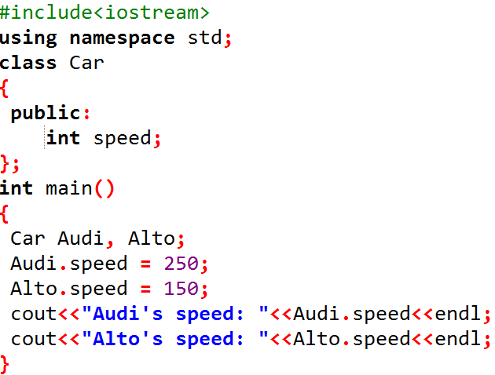
Accessing Public Data Members:
Accessed using the direct member access (.) operator with the object of that class.
Notes:
Accessing Public Data Members
Following is an example to show you how to initialize and use the public data members using the dot (.) operator and the respective object of class.

Slide 16
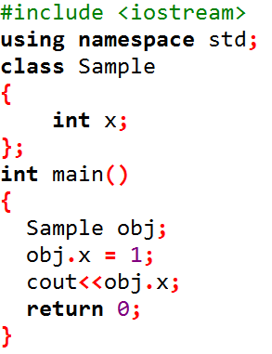
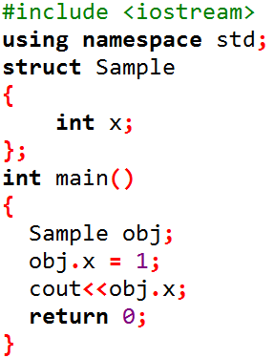
Class
Structure
By default members of a class are Private, so output will be error.
By default members of struct are public, output will be 1.
Notes:
1) Members of a class are private by default and members of struct are public by default.

